Slide 1

Play by Play Commentary with AI
Lucas and Sam

Slide 2
Using BLIP
Zero-Shot frame descriptions
No Pre-defined descriptions required

Slide 3
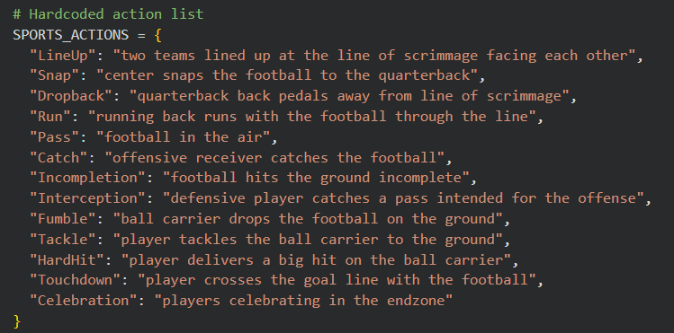
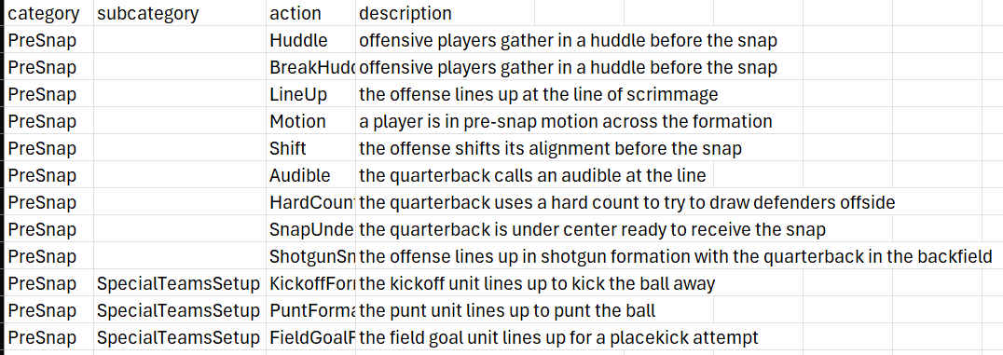
Using CLIP Models
Action list with subcategories
Action list with no subcategories

Slide 4
Vision Model - VideoMAE
Takes descriptions like CLIP
Designed to work with video and action

Slide 5
Audio Generation and Video Compilation
Generate commentary using Gemini
Feed into Suno/Bark
Overlay Audio with Original Clip

Slide 6
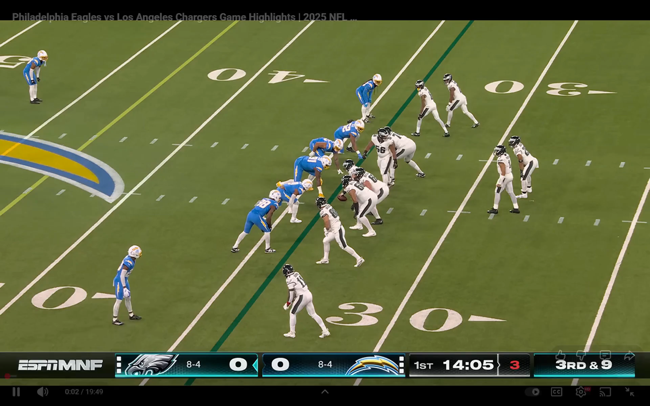
Results
BLIP performed the best
CLIP has decent results

